Slide 1


Limited by Time:
Actualizing Potential in Collaborative Processes
Dr. Donna Evans
DQP Video Conference
February 13, 2013

Slide 2
Time
Place
Kairos
Time
Place
Constraints

Slide 3
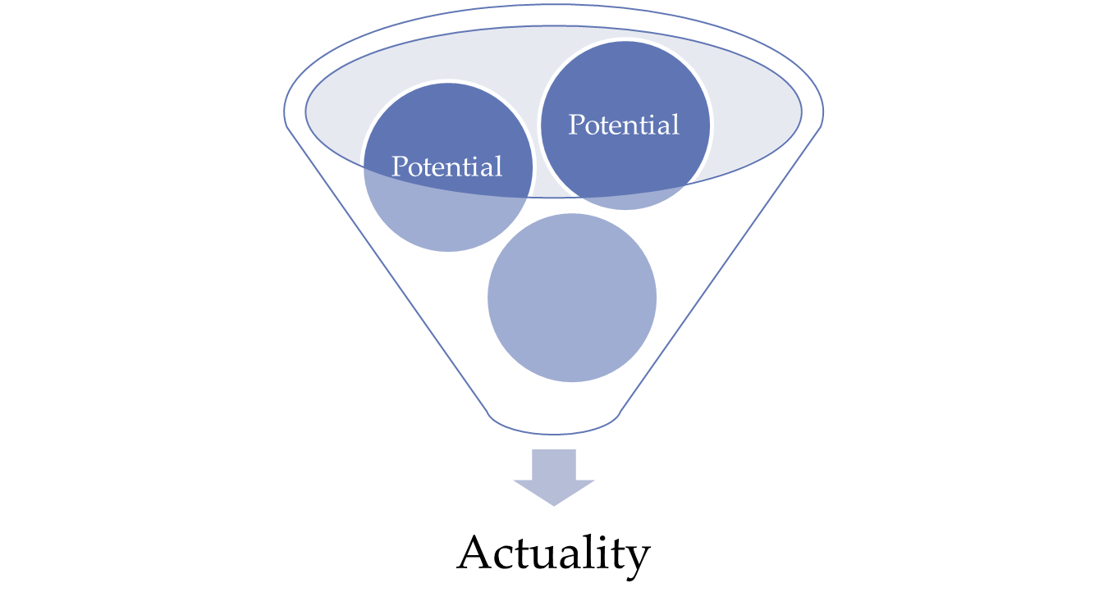
Entelechy
process by which potential is actualized

Slide 4
Recursivity
Ownership
Engagement
Outcome(s)

Slide 5
Looking Forward…
HIST
MATH
COMM
Horizontal Work of DQP

